Slide 1
Introduction to NoSQL and MongoDB
Vishwa

Slide 2
What does NOSQL stand for?
Not Only SQL database
is an alternative to traditional relational databases
useful for working with large sets of distributed data

Slide 3
How does NoSQL vary from RDBMS?
Looser schema definition
•Applications written to deal with specific documents/ data
•Applications aware of the schema definition as opposed to the data
•Designed to handle distributed, large databases
•Trade offs:
•No strong support for ad hoc queries but designed for speed and growth of database
•Query language through the API
•Relaxation of the ACID properties

Slide 4
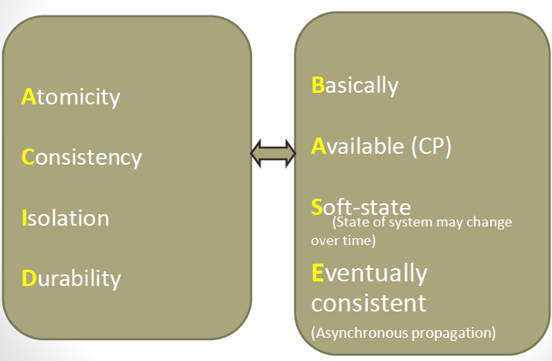

Slide 5
Benefits of NoSQL
Elastic Scaling
•RDBMS scale up –bigger load , bigger server
•NO SQL scale out –distribute data across multiple hosts seamlessly
DBA Specialists
•RDMS require highly trained expert to monitor DB
•NoSQL require less management, automatic repair and simpler data models
Big Data
•Huge increase in data RDMS: capacity and constraints of data volumes at its limits
•NoSQL designed for big data
Flexible data models
•Change management to schema for RDMS have to be carefully managed
•NoSQL databases more relaxed in structure of data
•Database schema changes do not have to be managed as one complicated change unit
•Application already written to address an amorphous schema
Economics
•RDMS rely on expensive proprietary servers to manage data
•No SQL: clusters of cheap commodity servers to manage the data and transaction volumes
•Cost per gigabyte or transaction/second for NoSQL can be lower than the cost for a RDBMS

Slide 6
Drawbacks of NoSQL
•Support
•RDBMS vendors provide a high level of support to clients
•Stellar reputation
•NoSQL –are open source projects with startups supporting them
•Reputation not yet established
•Maturity
•RDMS mature product: means stable and dependable
•Also means old no longer cutting edge nor interesting
•NoSQL are still implementing their basic feature set

Slide 7
Types of No SQL
Key-value stores
pairs a unique key with an associated value
Are extremely performing and highly scalable for session management and caching in web applications
they are oriented to work with RAM, solid-state drives or disk drives

Slide 8
Types of No SQL
Document databases
also called document stores
store semi-structured data and descriptions of that data in document format
allow developers to create and update programs without needing to reference master schema
JSON format support though XML is also supported
are used for content management and mobile application data handling

Slide 9
Types of No SQL
Wide-column stores
organize data tables as columns instead of as rows
can query large data volumes faster than conventional relational databases
used for recommendation engines, catalogs, fraud detection and other types of data processing

Slide 10
Types of No SQL
Graph stores
organize data as nodes, which are like records in a relational database, and edges, which represent connections between nodes
support richer representations of data relationships
the graph data model can evolve over time and use
reservation systems or customer relationship management

Slide 11
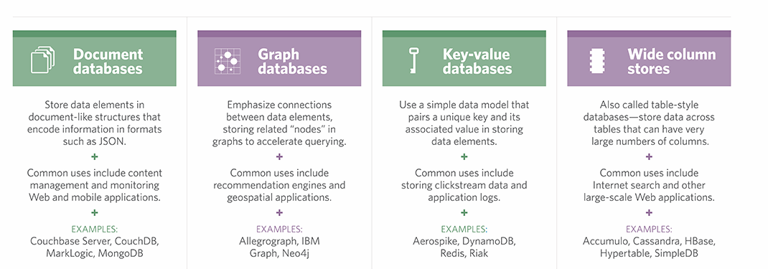
Different types of NO SQL

Slide 12
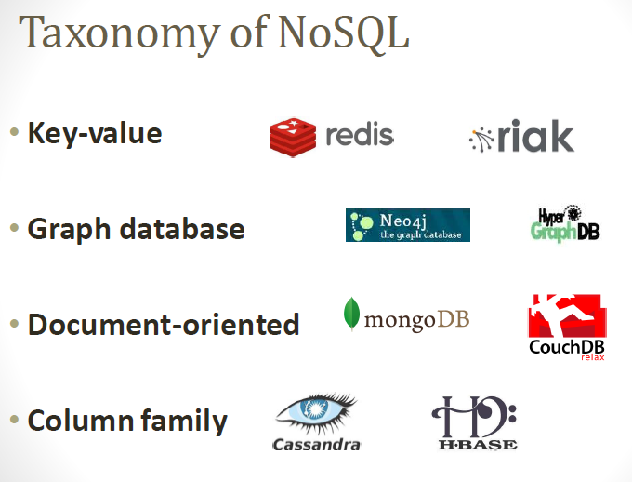

Slide 13
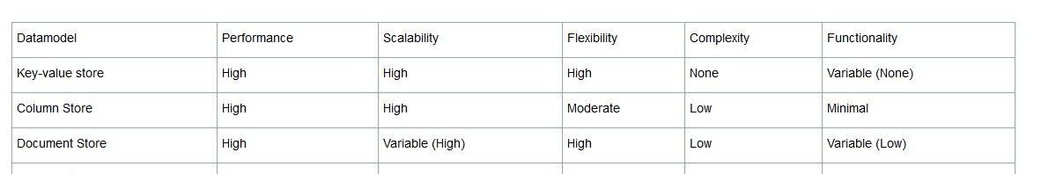

Slide 14
Mongo db
A document-oriented database
– documents encapsulate and encode data (or
information) in some standard formats or encodings
• NoSQL database
– non-adherence to the widely used relational database
– highly optimized for retrieve and append operations
• uses BSON format
• schema-less
– No more configuring database columns with types
• No transactions
• No joins

Slide 15
Mongo db history
Developed by 10gen
•Founded in 2007
•A document-oriented, NoSQL database
•Hash-based, schema-less database
•No Data Definition Language
•In practice, this means you can store hashes with any keys and values that you choose
•Keys are a basic data type but in reality stored as strings
•Document Identifiers (_id) will be created for each document, field name reserved by system
•Application tracks the schema and mapping
•Uses BSON format
•Based on JSON –B stands for Binary
•Written in C++
•Supports APIs (drivers) in many computer languages
•JavaScript, Python, Ruby, Perl, Java, JavaScala, C#, C++, Haskell, Erlang

Slide 16
Functionality of MongoDB
•Dynamic schema
•No DDL
•Document-based database
•Secondary indexes
•Query language via an API
•Atomic writes and fully-consistent reads
•If system configured that way
•Master-slave replication with automated failover (replica sets)
•Built-in horizontal scaling via automated range-based partitioning of data (sharding)
•No joins nor transactions

Slide 17
MongoDB Features
•Document-Oriented storage
•Full Index Support
•Replication & High Availability
•Auto-Sharding
•Querying
•Fast In-Place Updates
•Map/Reducefunctionality

Slide 18
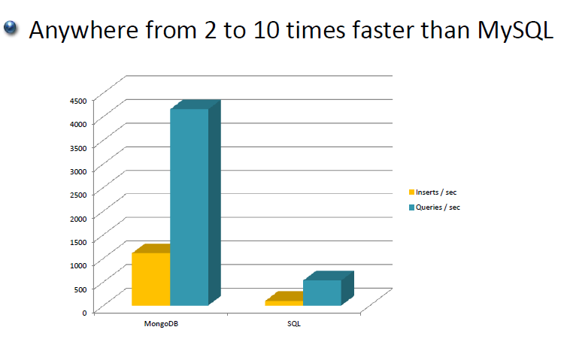

Slide 19
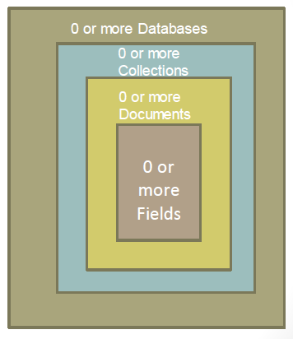
MongoDB: Hierarchical Objects

Slide 20
MongoDB: Hierarchical Objects
A MongoDB instance may have zero or more ‘databases’
•A database may have zero or more ‘collections’.
•A collection may have zero or more ‘documents’.
•A document may have one or more ‘fields’.
•MongoDB ‘Indexes’ function much like their RDBMS counterparts

Slide 21
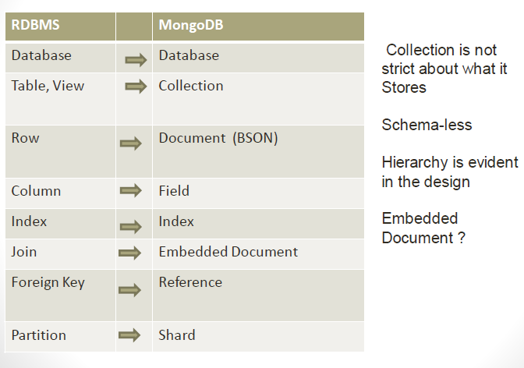

Slide 22
BSON format
•Binary-encoded serialization of JSON-like documents
•Zero or more key/value pairs are stored as a single entity
•Each entry consists of a field name, a data type, and a value
•Large elements in a BSON document are prefixed with a length field to facilitate scanning

Slide 23
JSON format
•Data is in name / value pairs
•A name/value pair consists of a field name followed by a colon, followed by a value:
•Example: “name”: “R2-D2”
•Data is separated by commas
•Example: “name”: “R2-D2”, race : “Droid”
•Curly braces hold objects
•Example: {“name”: “R2-D2”, race : “Droid”, affiliation: “rebels”}
•An array is stored in brackets []
•Example [ {“name”: “R2-D2”, race : “Droid”, affiliation: “rebels”},
•{“name”: “Yoda”, affiliation: “rebels”} ]

Slide 24
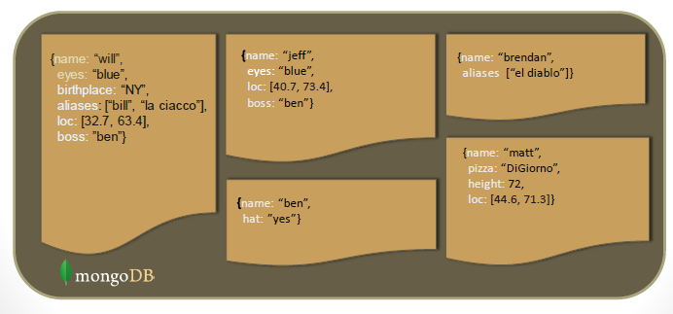
Schema Free name

